Slide 1
THE FOUNDER OF GENETICS IN SUDAN
DR. MUNTASIR IBRAHIM
IS IN PRISON

Slide 2
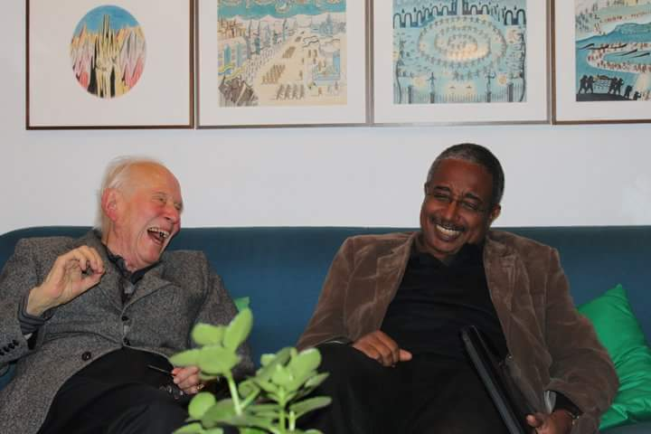
Notes:
Of the many feats, Luca Cavalli-Sforza was able to accomplish in his esteemed scientific career is the demonstration of the striking link between genes and languages as a manifestation of the force of genetic drift and role of culture as a genetic isolation mechanism.
Besides his deep insights into the issues pertinent to genetic history and geography, Luca was one of those pioneers on the theory of cultural transmission, today the science of memetics

Slide 3
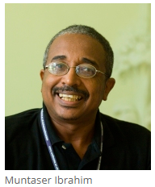
Dr. Muntasir Ibrahim
Education
1980 B. Sc. Zoology and chemistry, University of Zagazig.
1987 M.Sc. in Zoology, University of Khartoum.
1994 Faculty of Health Science University of Copenhagen Denmark.
Employment
2006- Present Professor Of Molecular Biology, Institute of Endemic Diseases, University of Khartoum.
2002-2006 Associate Professor and Head Department of Molecular Biology, Institute of Endemic Diseases, University of Khartoum.
1997 -2002 Assistant Professor, Institute of Endemic Diseases, University of Khartoum.
1997-1998 Welcome Visiting Research Fellow, Department of Pathology, University of Cambridge.
1983-1997 Research Scientist, National Health Laboratory Sudan.

Slide 4
Notable Achievements
Over 200 publications.
Over 6000 citations.
Authored “Dissecting The Racial mind, Assays on race and Science” (inpress) .
Translated “The Great Human Diasporas, The history of human genetic diversity and evolution”, By LL.Cavalli-Sforza (to Arabic).
Recipient of the prestigious “CNR Rao Prize”.
Founding member of the Sudanese National Academy of Science (SNAS) in Khartoum.
Member of the World Academy of Sciences in Trieste, Italy.
Activist in various civil societies in Sudan, and prominent advocate for the advancement of science across the globe, and in Africa specifically.

Slide 5
Events Leading to Detention of Muntasir
Eventi precedenti la sua incarcerazione Il Presidente del Sudan, Omer Elbashir, è al potere ininterrottamente dal 30 Giugno 1989 dopo un colpo di Stato.L'economia del Sudan si è deteriorata significativamente negli ultimi 8 anni. Il tasso di inflazione è cresciuto di più del 100% negli ultimi 2 anni. Nel tentativo di trovare la via per una transizione pacifica del potere e di evitare un collasso economico totale Muntasir ha lavorato insieme a diversi suoi colleghi e ha sviluppato un'iniziativa sostenuta da oltre 700 membri dello staff dell'Università di Khartoum. Come presidente di questa iniziativa, è diventato il bersaglio dell'apparato di sicurezza sudanese (NISS)).
President Omer Elbashir has been running Sudan without interruption since June 30th 1989 after a military coup.
Sudan’s economy has been deteriorating significantly over the past 8 years. Inflations rates have passed 100% over the past 2 years.
In an effort to find a path for a peaceful transition of power, and avert a total economic collapse, Muntasir worked along with several of his colleagues and developed an initiative that was backed by over 700 staff members from the University of Khartoum.
As the president of this initiative, he became the target of the Sudanese security apparatus (NISS).

Slide 6
Arbitrary Detention
Dr. Ibrahim Muntasir was arrested on the 3rd and 6th of January by Sudanese security forces. He was released the same day both times.
On the 21st of February he was arrested by security forces, along with several other political and civil society leaders from a Mosque in Khartoum.
He has remained in arbitrary detention since then at a NISS political detention centre. His family was allowed to see him once, a month after his arrest; subsequent requests for a visit have been rejected.
No charges have been filed against him in any of his arrests, and there is still no estimated time of release.

Slide 7
PETITION FOR THE RELEASE FROM PRISON OF PROF MUNTASIR IBRAHIM
The undersigned, gathered in the city of Pavia (Italy) to celebrate the life and work of Prof Luigi Luca Cavalli-Sforza, a founder of population genetics, for the reasons explained in the enclosed appeals, request the Sudanese Authorities to release from prison Prof. Muntasir Ibrahim, vice president of the Sudanese National Academy of Sciences and professor in the University of Khartoum’s Department of Molecular Biology, Institute of Endemic Diseases, who suffers from a chronic heart condition that requires special medical attention.
Prof Ibrahim is one of the most distinguished scholars in the fields of genetics and cancer research, and an advocate for peaceful ways of ending conflict, including advocating for population genetics to be the vehicle of peace and harmony in Africa.
ENCLOSED:
1) Appeal of the International Human Rights Network of Academies and Scholarly Societies (H.R. Network), an alliance of more than 90 national academies and scholarly societies that defends the fundamental rights of fellow academics and health professionals worldwide and supports academic and medical institutions under threat (15 March 2019)
2) Statement to Demand the Release of Professor Muntasir Ibrahim, by the African Society of Human Genetics (13 February 2019)
3) The Plight of Muntaser Ibrahim, published in PLOS Genetics on 25 March 2019 by seven scientists (https://doi.org/10.1371/journal.pgen.1008100).
NAME PROFESSION AND AFFILIATION CITY, COUNTRY
1) Giovanni Romeo Medical Geneticist - Bologna University and ESGM Italy

Slide 8
Instructions for signing this petition on line or by e-mail will be provided soon

Slide 9
